Slide 1
Car Prediction APP
By: Yiscah Mark

Slide 2
This app is trained with the forest regressor model on a very large set of car data. The data includes many variables such as the company, fuel type, year, and mileage of the car…The model is trained to predict the target variable, which is the price.

Slide 3
Users can enter a car's variable information, and the app will provide a price prediction.

Slide 4
I used the RANDOM FOREST REGRESSOR MODEL to fit my model because this model is very good at catching non-linear patterns. The random forest model uses many decision trees to find patterns in the data. It is also resistant to overfitting.

Slide 5
I followed the CRISP-DM methodology for this project.
I cleaned and explored the data
I then prepared the features for analysis
Next, I built a random forest regressor model and then serialized it to a transportable file format
Last, the model is ready for deployment, where a user can get a real-time prediction for a used car.

Slide 6
For my app to be fully operational, I would need to move the model to a web server so anyone can access it. I would also need to build a clean, standard webpage using HTML or Streamlit, hosted in the cloud. I would also need to keep the prices up to date. I could do this by automating the ingestion of more sample data for the model to train on. That’s how the model would catch new inflation and market trends.

Slide 7
Questions and Confusions…
I am still unsure about how exactly the model and code become a real-life application. Because of my filter issues, I was never able to actually see the app. Instead, I created a replica sort of model that accepts input in the Jupyter notebook.

Slide 8
Write-up
This term project was to create an interactive model to predict the prices of used cars using the used-car dataset. The first important step was to upload and clean the data. The data included variables such as the car’s model name, mileage, fuel type, year, ignition type, and other details. The target variable was the price. Many formatting and spelling issues arose, as did outliers that skewed the model and too many variables that could lead to overfitting. An interesting way I handled the name column was to extract the first word of each model name. The first word is usually the company, and this way, there were fewer options that actually held weight in the model.
The next step was to prepare and run the model on my data. I split the prices into y and the other variables into x. I then trained the model on most of the data, reserving a small portion for testing the model’s performance. I used the random forest regression model. This model uses multiple decision trees to predict the data. I recall that the performance metrics were not very great. I think the main reason was overfitting. There are so many different variables to take into account. Also, a few major outliers skewed the data.
Regardless of the model’s performance, I serialized it to a transportable file format.
The last and most important part is to deploy the model so it can be used by app users to make real-time predictions. This is where all the hard work finally comes into play. I bumped into a big hiccup on the way. Jupyter notebooks and Streamlit don’t get along very well. While I got a link to the app I created, I could not open it due to firewall and proxy issues. Instead, I recreated a similar dashboard in my local notebook that accepted input and made predictions with the real-time data I entered. This app cannot be accessed by anyone over the internet. That is really the main point and my next step.
I tried a few predictions, and while I don’t think they were very accurate, the older car with more mileage was correctly estimated to sell for less than the new one with less mileage.

Slide 9
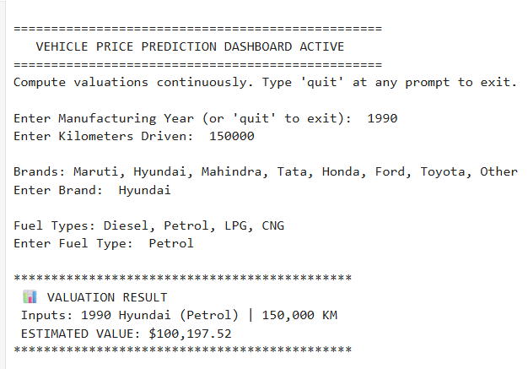
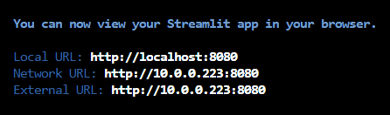
These are screenshots of my app. I spent many hours trying to work around the issue. This is the best I came up with. Thank you for everything, Professor Scott.
Attribution: I used Google Gemini for the code snippets.

